Slide 1

Analysing the gross of 500 greatest movies in the IMDb website
BY
P.R.R.Vamsi Krishna
M.V.Murali Mohan

Slide 2
About me:
Name : M.V.MURALI MOHAN (B.TECH,MECHANICAL ENGINEERING)
I opted to do Data science for it helps me to get good job.

Slide 3
PREFACE :
INTRODUCTION
PROBLEM STATEMENT
TOOLS (LIBRARIES)USED
RAW DATA
CLEANED DATA
DATA VISUALIZATION
OBSERVATIONS
CONCLUSION

Slide 4

INTRODUCTION
Internet Movie Database (IMDb) is an online database of information related to films, television series, podcasts, home videos, video games, and streaming content online – including cast, production crew and personal biographies, plot summaries, trivia, ratings, and fan and critical reviews.
IMDb began as a fan-operated movie database on the Usenet group "rec.arts.movies" in 1990, and moved to the Web in 1993. Since 1998, it has been owned and operated by IMDb.com, Inc., a subsidiary of Amazon.
As of March 2022, the database contained some 10.1 million titles (including television episodes) and 11.5 million person records. Additionally, the site had 83 million registered users. The site's message boards were disabled in February 2017.
As of 2019, IMDb is the 52nd most visited website in the world, according to website ranker Alexa.

Slide 5
PROBLEM STATEMENT
Perform analysis and suggest basic recommendations based on Gross and which users prefer
Comparison of gross for different Genres
Recommendations that are based on Rating
This project helps us to understand the correlation between these factors

Slide 6




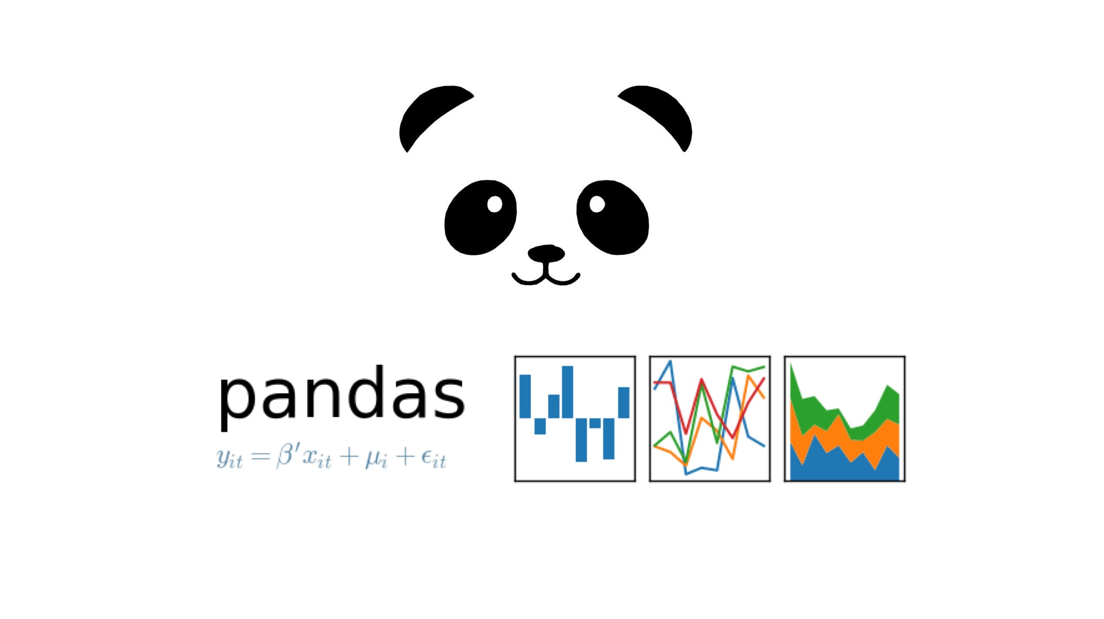

TOOLS (LIBRARIES) USED
Requests
Beautiful Soup
Pandas
NumPy
Matplotlib
Seaborn

Slide 7
WEB SCRAPPING
Web Scrapping Is an automatic way to retrieve unstructured data from a website and store them in a structured format.
PROCESS
Taking the website that you want to work.
Access the URL of website using code and download all
the HTML contents on the page.
Find out the request-response that gives you the data
that you want.
Depending on the type of request(post or get)simulate
the request in your code and retrieve the data from API
Extract out useful info that you need.

Slide 8
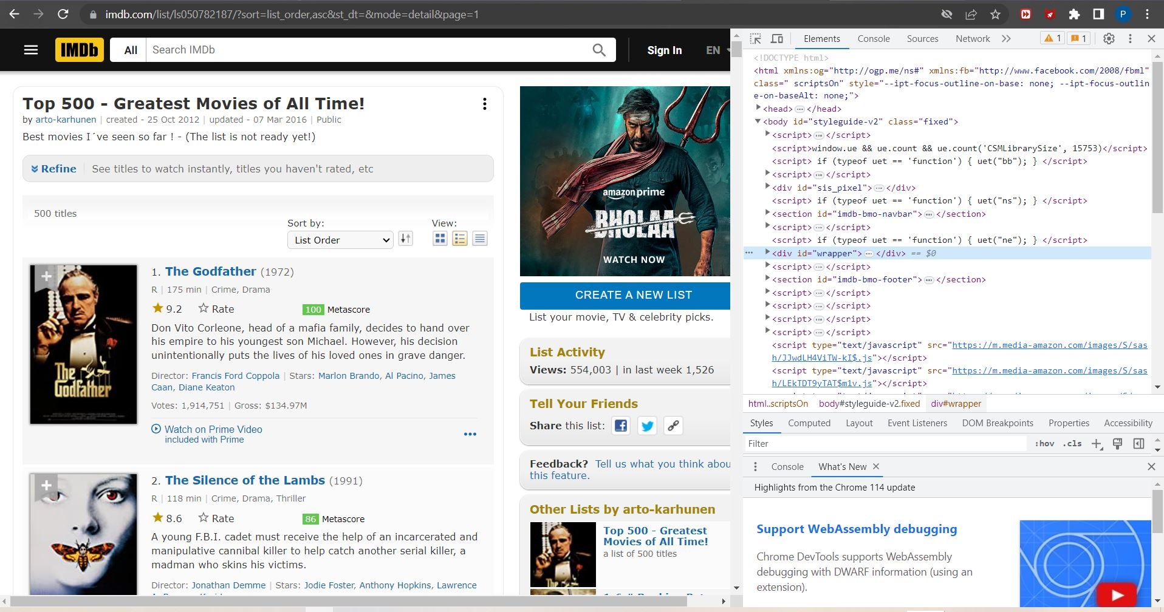
DATA COLLECTION
https://www.imdb.com/list/ls050782187/?sort=list_order,asc&st_dt=&mode=detail&page=1

Slide 9
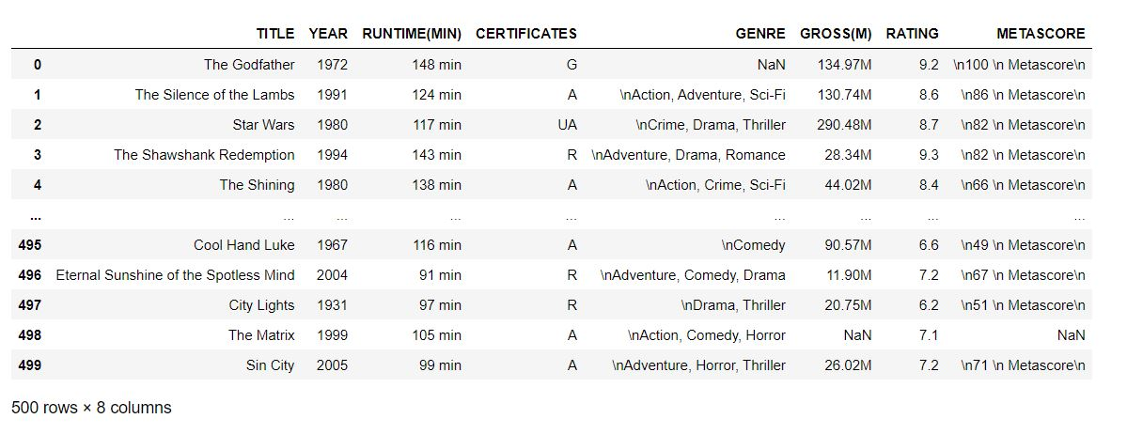
RAW DATA

Slide 10
DATA CLEANING STEPS
Removing special characters and converting dtypes.
Searching for missing and nan values and filling them with the techniques.
Searching for Duplicate Values.
Finding Outliers and removing
The Final Data Structure is with 500 rows and 8 columns

Slide 11
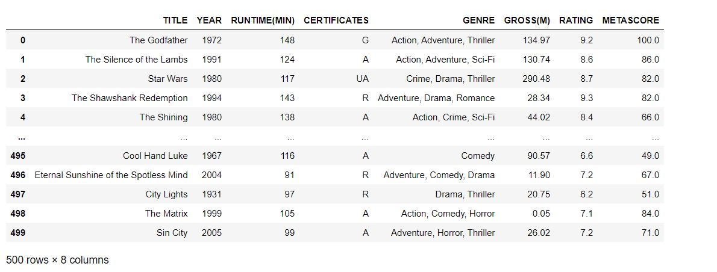
DATA AFTER CLEANING

Slide 12

DATA VISUALIZATION
It is a graphical representation for analyzing complex data, identifying patterns and extracting valuable insights

Slide 13
MATPLOTLIB and SEABORN
Matplotlib and Seaborn are python libraries that are used for data visualization. They have inbuilt modules for plotting different graphs
We perform the data visualization in 3 ways:
UNI-VARIATE ANALYSIS
BI-VARIATE ANALYSIS
MULTI-VARIATE ANALYSIS

Slide 14
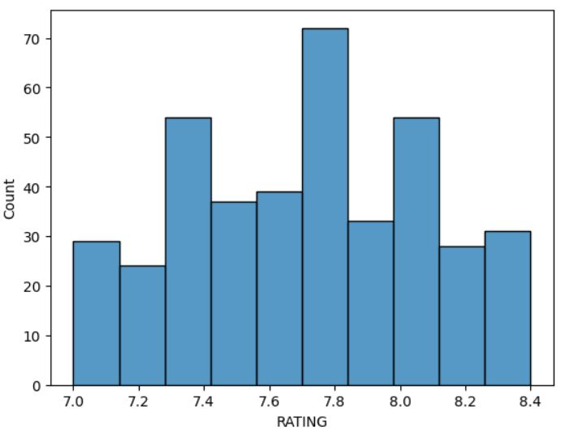
RATING
From the plot we can analyze the ratings of movies which has more number of count
Here there are more movies with 7.8 IMDb rating
The high rated movies with 8.4 IMDb are lesser than the average rated movies
From this we can conclude that the top rated movies are very few compared to other movies

Slide 15
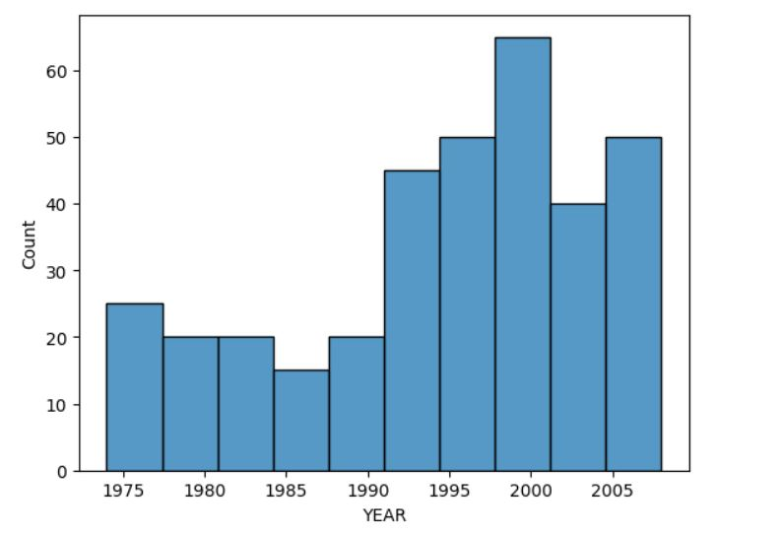
YEARS
From the graph we can understand that there are more releases of movies around the years from 1995-2000.
There is a gradual increase in movie releases from 1990-2005
Hence we can assume movie production is increased in 1990-2005

Slide 16
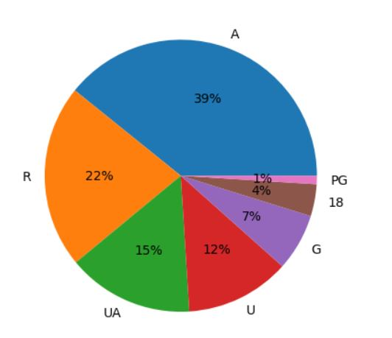
CERTIFICATION
from the pie chart we can get to know the percentage of movies with certified
from pie chart there are ‘A’ certified movies with 39% occupying major part of the pie
Only 1% of ‘PG’ rated movies has been produced

Slide 17
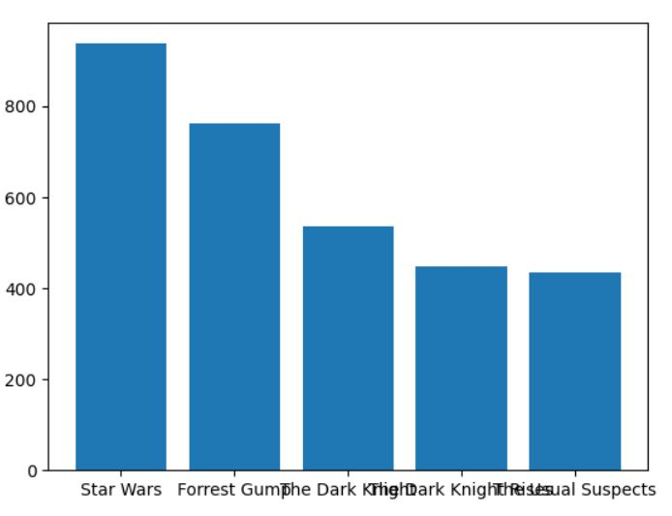
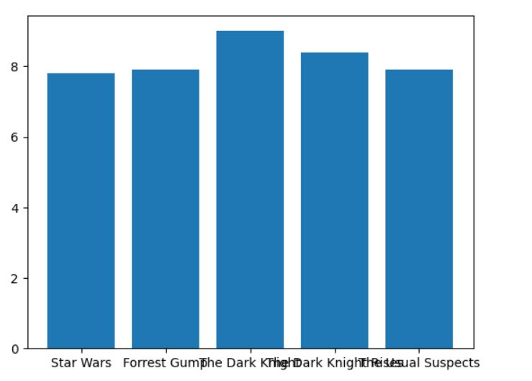
TOP 5 GROSSING and RATED MOVIES
From the data set the top most grossing movies are taken
As from the plot the top five grossing movies are
Star wars , Forrest Gump, The Dark Knight, The Dark Knight Rises, Usual Suspects are the top 5 grossing movies in IMDb
As well the top rated movies are also occupied by these movies

Slide 18
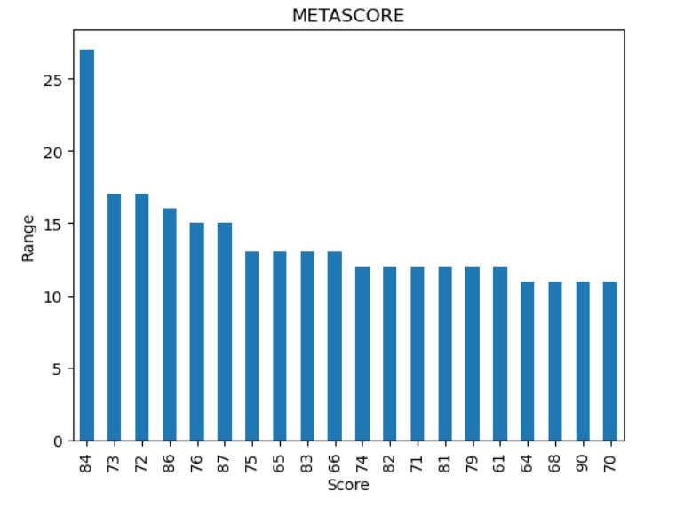
METASCORE
metascore helps us to calculate the rating among the number of reviews given
From the overall movies released there are major amount of movies with metascore of 84
Highest rate of metascore is 90 which has only around 10-11 range from the graph

Slide 19
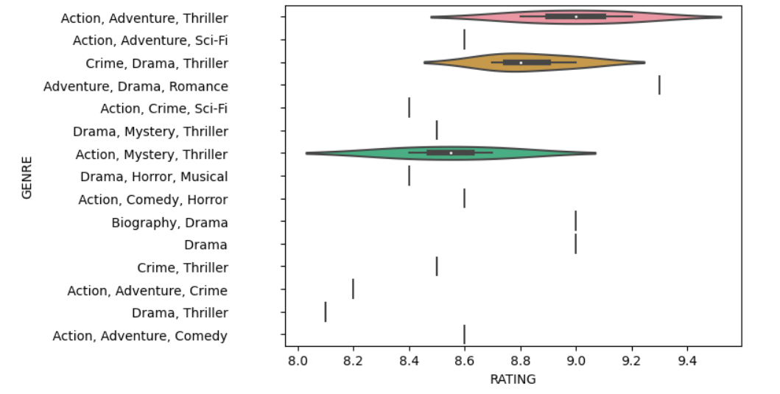
GENRES BASED ON RATING
From the observations mostly thriller movies are having major amount of ratings
Combination of action thriller adventure has around 8.5-9.5 stars in IMDb rating

Slide 20
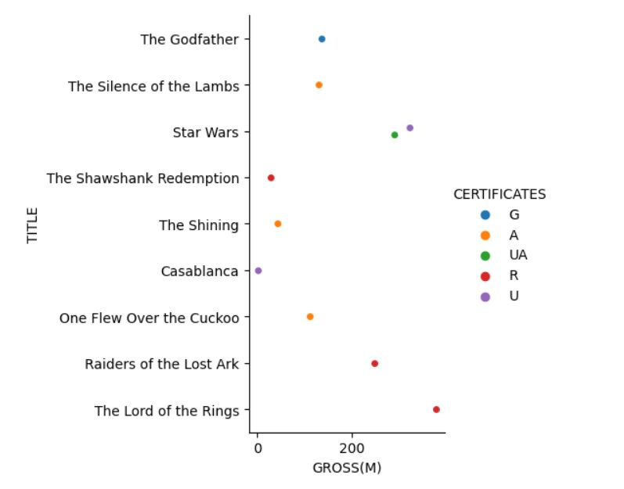
CERTIFICATES
Choosing top 10 grossing movies with certification given by film board
the lord of the rings movie which has highest gross collection got R certification from the film board
The least gross collected movie Casablanca got U certification from the film board

Slide 21
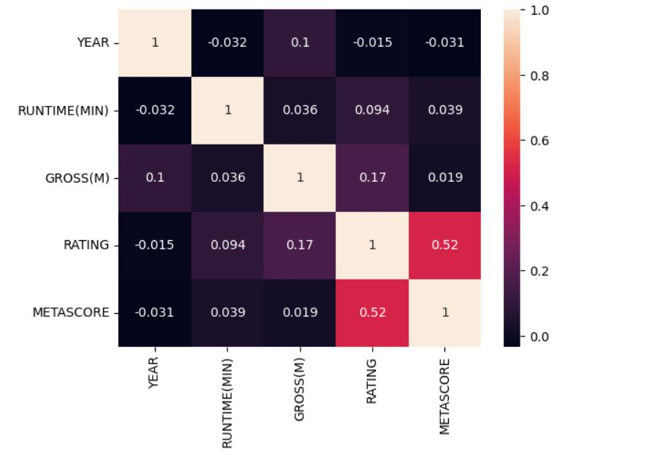
HEATMAP
This heat map is used to find the relation strength between the numerical data from the data frame
Relation between data points are classified by the color intensity
If the color is lite the relation is weaker and high color has the strong bond between the data points
From heat map gross and year has positive correlation
Runtime and year has negative relation

Slide 22
CHALLENGES FACED
Finding the website for data collection
We faced more Challenge while Collecting the data from Website
Cleaning of data

Slide 23
CONCLUSIONS
From ratings we can conclude that the top rated movies are very few compared to other movies.
Movie production is increased in 1990-2005 .
Star wars is the top grossing movies in IMDb.
The dark knight is the top rated movie in IMDb.
From the overall movies released there are major amount of movies with metascore of 84.
Combination of action thriller adventure has around 8.5-9.5 stars in IMDb rating.
From the above data analysis we can suggest genre, top grossing movies, high rated movies to users for watching.

Slide 24

THANK YOU

